Slide 1
Sampling Distribution
Population
BUT, in practice we don’t see the “tree” or all of the “seeds” – we only have ONE seed
µ

Slide 2
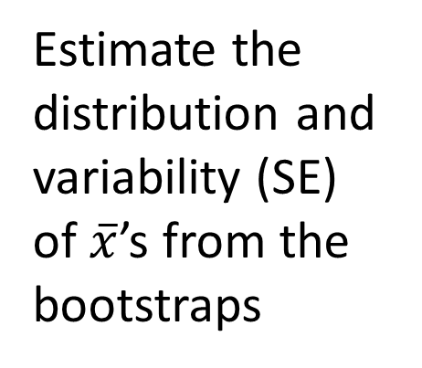
Bootstrap Distribution
What can we do with just one seed?
Bootstrap
“Population”
Estimate the distribution and variability (SE) of $\overline{x}$’s from the bootstraps
Grow a NEW tree!
$$\overline{x}$$
µ

